Slide 1
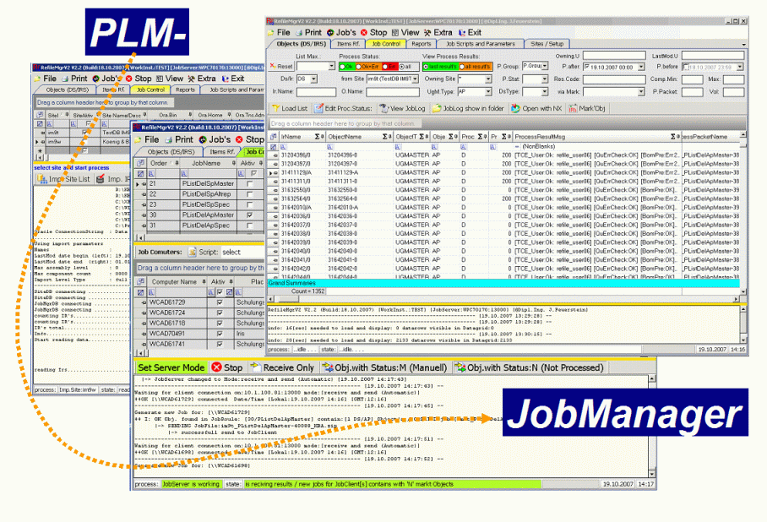
PLMJobManagerV2
PLM Data Check Documentation
#CustomerName#
Created by : #Name#
Creation Date : #Date#
Notes:
Josef Feuerstein
Klaus Scholz

Slide 2
#Date# Check #Item# #Rev#
#Description#

Slide 3
#Date# Check #Item# #Rev#
#Description#
Template Slide
Copy this Slide first and add
your Documentation into copied slide

