Slide 1
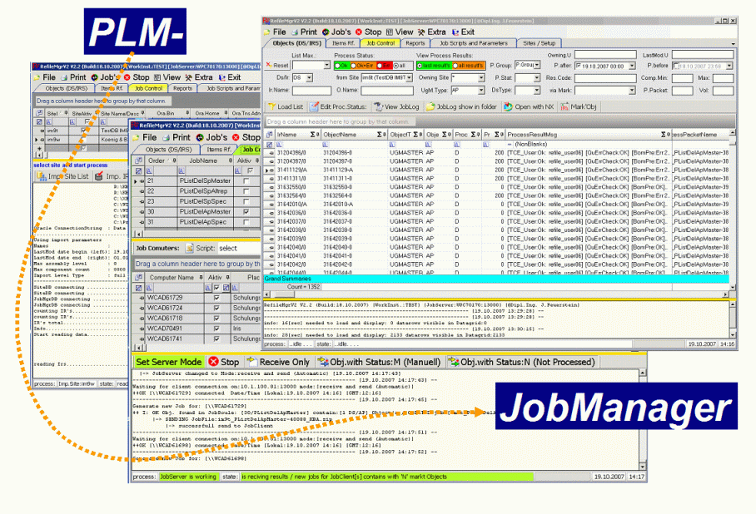
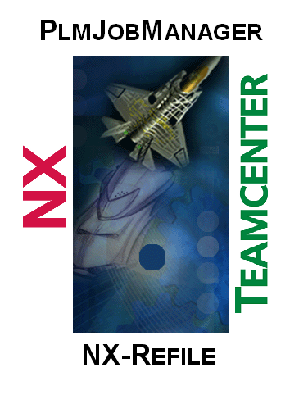
PLMJobManager – TC Site COns
Author: Josef Feuerstein

Slide 2
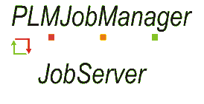


System Sketch TC + JobManager
Vol1
C4
Import
JobMgr DB + Config
JobServer
DB (MSSQL)
Vol2
Teamcenter
LEAD
Lead Site
C2
C2
C1
Vol3
DEMCHTC00PA.ww500.siemens.net
TC Datashare
C2
C2
C2
Vol1
Teamcenter
RO Site 1
RO Site 2
Teamcenter
RO Site 2
RO Site 3
Teamcenter
RO Site 3
RO Site 1
Vol1
Vol1
C4
C4
C4
Vol2
Vol2
Vol2
Import
C1
C1
C1

Slide 3
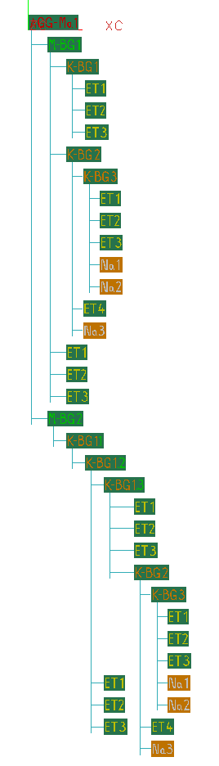
How to Refile?
Botton - Up Prinzip:
The Refile of the Nx Data should be done via Bottom Up Principe.
The advance is that the refile of Assembly is systematic processed from Bottom Up. It reduces the time of refile and improves the final Data quality
Therefore the Parts and Processed in this order:
First all = Single Part‘s (SP)
All Assembly's (AP) started with the lowest mound of levels and components. AP1 has 1 Level 5 Component AP2 has 2 Level’s 8 Component AP3 has 3 Level’s 12 Component AP4 has 4 Level’s 16 Component
AP4
AP3
SP
SP
SP
AP2
AP1
SP
SP
SP
SP
SP
SP
SP
SP
SP
SP

Slide 4


#Templates – Designs #Version: 07.02.2018/J.Fes
1
XX
XX
# Standard Labels
2
XX
XX
OK
XX
XX
WRN
XX
XX
ERR
XX
XX
XX
XX
XX
XX
# Standard Symbols
# Colour coding
Document description
Isssue description
# Standard Connection lines
#ToDo descrption
#Done desctprion

