Slide 1
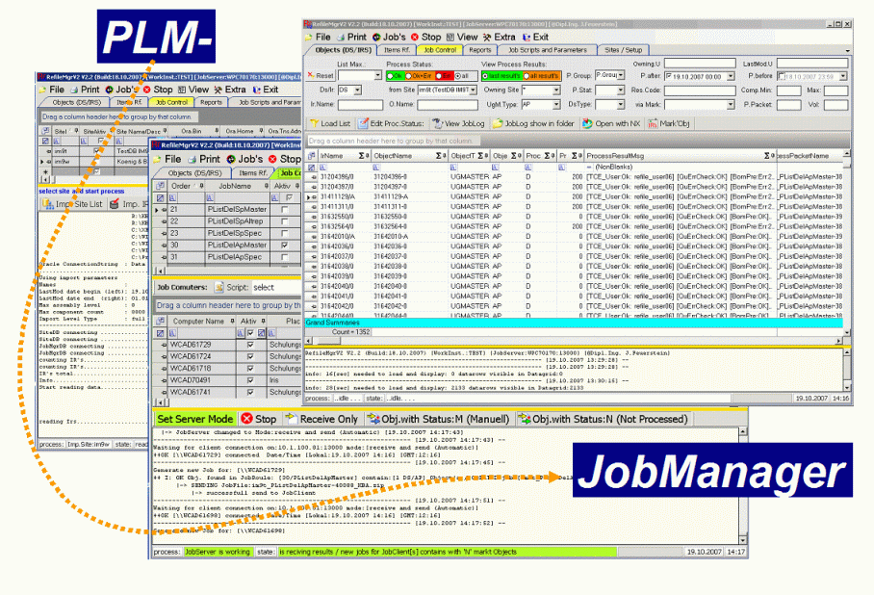
PLM JobManager
N N N N N N N N N N N N N N N N N N N N N N
N N N N N N N N N N N N N N N N N N N N N N
Setup Dokumentation
TCSite Cons
Created by : S.Güth / J.Feuerstein
Creation Date : 11/2015
Notes:
Josef Feuerstein
Klaus Scholz

Slide 2
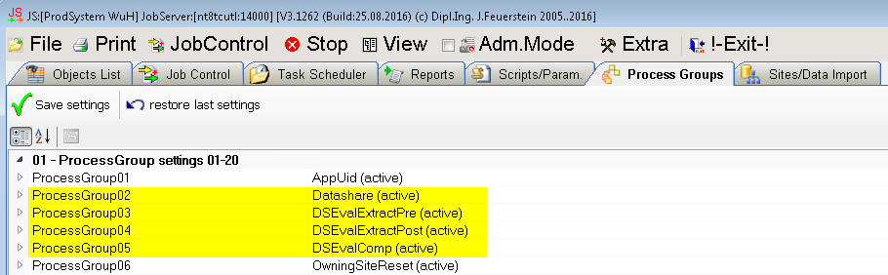
Setup process groups
Setup a process group for each step:
Datashare → for transfering objects from source to target site
DSEvalExtractPre → for extracting object data from the database on source site
DSEvalExtractPost → for extracting object data from the database on target site
DSEvalComp → to compair the extracted data from source and target site

Slide 3
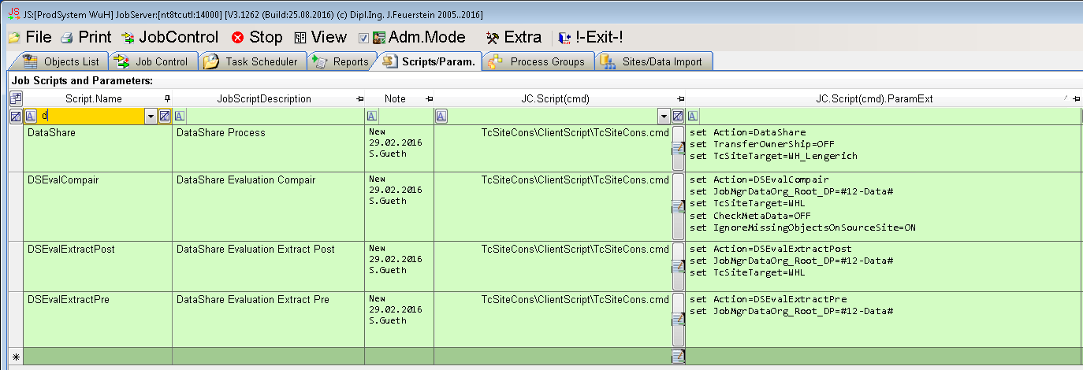
Setup scripts / parameters
DataShare | set Action=DataShare set TransferOwnerShip=OFF set TcSiteTarget=WH_Lengerich
DSEvalCompair | set Action=DSEvalCompair set JobMgrDataOrg_Root_DP=#12-Data# set TcSiteTarget=WHL set CheckMetaData=OFF set IgnoreMissingObjectsOnSourceSite=ON
DSEvalExtractPost | set Action=DSEvalExtractPost set JobMgrDataOrg_Root_DP=#12-Data# set TcSiteTarget=WHL
DSEvalExtractPre | set Action=DSEvalExtractPre set JobMgrDataOrg_Root_DP=#12-Data#

Slide 4
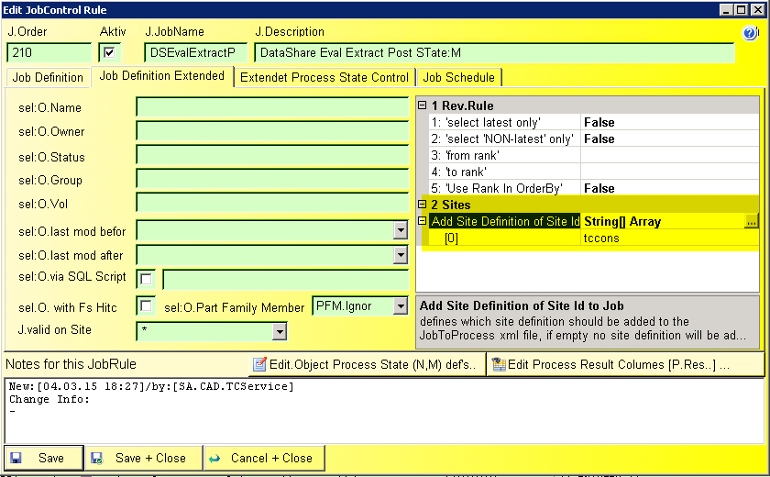
Setup Jobs
Jobs will be executed for Items of all types!
Attention:
for the jobs DSEvalExtractPre and DSEvalExtractPost in the job defenition under
Job Definition Extended > Sites > Add Site Definition of Site ID
the site id of the extraction site has to be added
DSEvalExtractPre → source site id
DSEvalExtractPost → target site id
Notes:
Datarow details of......: Job Scripts and Parameters:
Script.Name.............: Datashare
JobScriptDescription....: script for datashare
JC.Refile.Param.........:
JC.Script(cmd).ParamExt.: set Action=DataShare
set TransferOwnerShip=OFF
set TcSiteTarget=tccons
JC.Script(cmd)..........: TcSiteCons\ClientScript\TcSiteCons.cmd
Note....................: new 04.03.2015 S.Gueth
-------------------------------------------------------------------- [22.06.2015 13:15:25] --
Datarow details of......: Job Scripts and Parameters:
Script.Name.............: DSEvalCompair
JobScriptDescription....: DataShare Evaluate Compair
JC.Refile.Param.........:
JC.Script(cmd).ParamExt.: set Action=DSEvalCompair
set JobMgrDataOrg_Root_DP=#12-Data#\JobMgrData
JC.Script(cmd)..........: TcSiteCons\ClientScript\TcSiteCons.cmd
Note....................: new 05.03.2014
-------------------------------------------------------------------- [22.06.2015 13:15:25] --
Datarow details of......: Job Scripts and Parameters:
Script.Name.............: DSEvalExtractPost
JobScriptDescription....: DataShare Evaluate Extract Post
JC.Refile.Param.........:
JC.Script(cmd).ParamExt.: set Action=DSEvalExtractPost
set JobMgrDataOrg_Root_DP=#12-Data#\JobMgrData
set TcSiteTarget=tccons
JC.Script(cmd)..........: TcSiteCons\ClientScript\TcSiteCons.cmd
Note....................: new 04.03.2015 S.Gueth
-------------------------------------------------------------------- [22.06.2015 13:15:25] --
Datarow details of......: Job Scripts and Parameters:
Script.Name.............: DSEvalExtractPre
JobScriptDescription....: DataShare Evaluate Extract Pre
JC.Refile.Param.........:
JC.Script(cmd).ParamExt.: set Action=DSEvalExtractPre
set JobMgrDataOrg_Root_DP=#12-Data#\JobMgrData
JC.Script(cmd)..........: TcSiteCons\ClientScript\TcSiteCons.cmd
Note....................: new 04.03.2015 S.Gueth

Slide 5
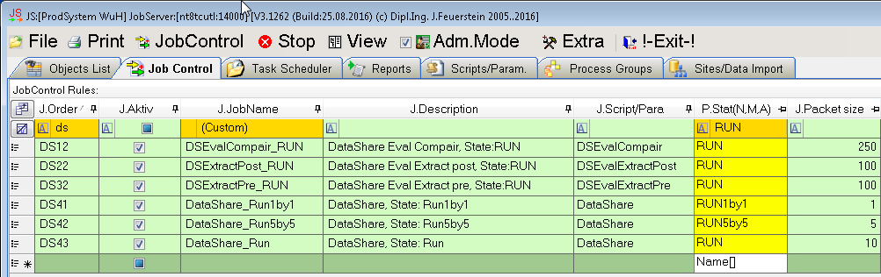
Setup Jobs
Overview of all jobs and the job order:
Notes:
Datarow details of......: Job Scripts and Parameters:
Script.Name.............: Datashare
JobScriptDescription....: script for datashare
JC.Refile.Param.........:
JC.Script(cmd).ParamExt.: set Action=DataShare
set TransferOwnerShip=OFF
set TcSiteTarget=tccons
JC.Script(cmd)..........: TcSiteCons\ClientScript\TcSiteCons.cmd
Note....................: new 04.03.2015 S.Gueth
-------------------------------------------------------------------- [22.06.2015 13:15:25] --
Datarow details of......: Job Scripts and Parameters:
Script.Name.............: DSEvalCompair
JobScriptDescription....: DataShare Evaluate Compair
JC.Refile.Param.........:
JC.Script(cmd).ParamExt.: set Action=DSEvalCompair
set JobMgrDataOrg_Root_DP=#12-Data#\JobMgrData
JC.Script(cmd)..........: TcSiteCons\ClientScript\TcSiteCons.cmd
Note....................: new 05.03.2014
-------------------------------------------------------------------- [22.06.2015 13:15:25] --
Datarow details of......: Job Scripts and Parameters:
Script.Name.............: DSEvalExtractPost
JobScriptDescription....: DataShare Evaluate Extract Post
JC.Refile.Param.........:
JC.Script(cmd).ParamExt.: set Action=DSEvalExtractPost
set JobMgrDataOrg_Root_DP=#12-Data#\JobMgrData
set TcSiteTarget=tccons
JC.Script(cmd)..........: TcSiteCons\ClientScript\TcSiteCons.cmd
Note....................: new 04.03.2015 S.Gueth
-------------------------------------------------------------------- [22.06.2015 13:15:25] --
Datarow details of......: Job Scripts and Parameters:
Script.Name.............: DSEvalExtractPre
JobScriptDescription....: DataShare Evaluate Extract Pre
JC.Refile.Param.........:
JC.Script(cmd).ParamExt.: set Action=DSEvalExtractPre
set JobMgrDataOrg_Root_DP=#12-Data#\JobMgrData
JC.Script(cmd)..........: TcSiteCons\ClientScript\TcSiteCons.cmd
Note....................: new 04.03.2015 S.Gueth

Slide 6
Datashare Know-how
New: 23.11.2015
Where will the data be stored during data share / data sync process ?
If the process user exists on both sites then the data will be stored in default volume of user in target site
→ Users have to be replicated
If the process user does not exist on the target site the default volume of the idsm user will be uses

Slide 7
Mitschrift #Date#
….
Xxx
xxx
Template Slide
Copy this Slide first and add
your Documentation into copied slide

