Slide 1
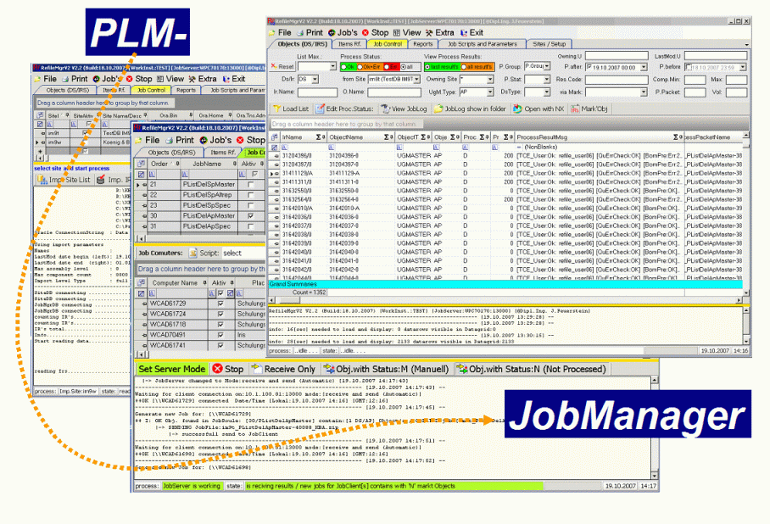
PLMJobManagerV3 RefileNx10 – Setting
Erstellt von:
Josef Feuerstein
Erstellt von:
Josef Feuerstein

Slide 2
Inhaltsverzeichnis
Refile Process Basic Workflow Folie: 3 Refile Process Workflow Settings Folie: 4 NX10.5 Settings Folien: 5 - 7 Refile Method is enhanced Folie: 8 Refile Section configuration Folie: 9 NX – TC Relevant Settings Folie: 10 Hilfsmittel - Designs Folie: 11

Slide 3





Refile Process Basic Workflow
Schema below shows how “Job.Rules” and “Object Status” is controlling the refile process
Job.Rules
Objects before refile
;-- #Rule of Rf011:
[RuleID=Default] [P.Stat=D]
[RuleID=OK] [O.Type=*] [J.ResCode=0] [J.ResMsg=*] [J.ResWarn=0] [P.Stat=D.OK]
[RuleID=WRN] [O.Type=*] [J.ResCode=0] [J.ResMsg=*] [J.ResWarn=1] [P.Stat=D.WRN]
[RuleID=ERR] [O.Type=*] [J.ResCode<>0] [J.ResMsg=*] [J.ResWarn=*] [P.Stat=D.RUN1.ERR]
Refile 1 Start
OR
RUN Refile Rf011
OK?
Yes
D.OK or D.WRN
NO
D.RUN1.ERR
Objects after 2. Refile
;-- #Rule of Rf012:
[RuleID=Default] [P.Stat=D]
[RuleID=OK] [O.Type=*] [J.ResCode=0] [J.ResMsg=*] [J.ResWarn=0] [P.Stat=D.OK]
[RuleID=WRN] [O.Type=*] [J.ResCode=0] [J.ResMsg=*] [J.ResWarn=1] [P.Stat=D.WRN]
[RuleID=ERR] [O.Type=*] [J.ResCode<>0] [J.ResMsg=*] [J.ResWarn=*] [P.Stat=D.RUN2.ERR]
Refile 2
OR
RUN Refile Rf012
OK?
Yes
D.OK or D.WRN
NO
D.RUN2.ERR
Refile 3
.. Using same Schema like in Refile 1 .. 2

Slide 4
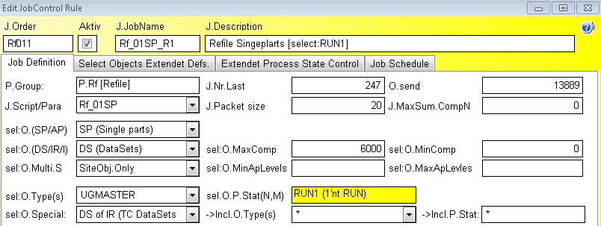
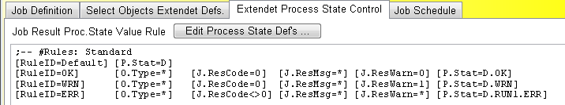
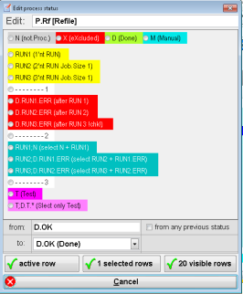
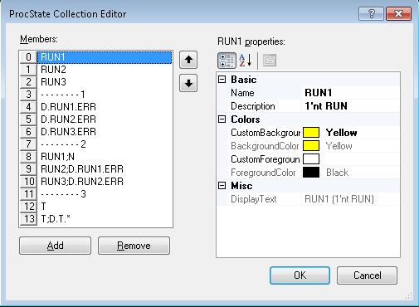
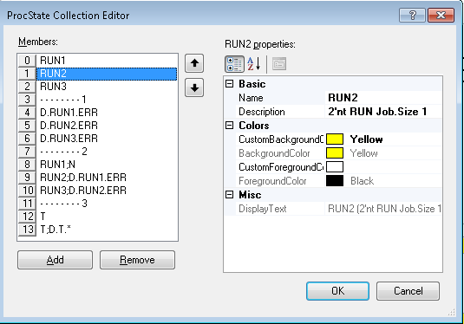
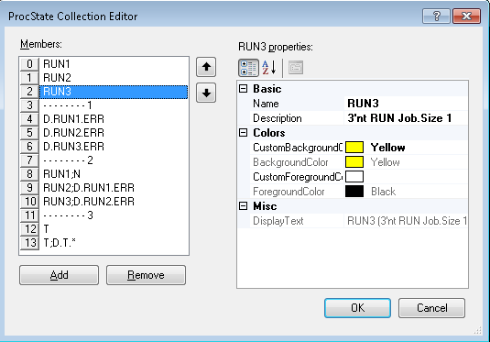
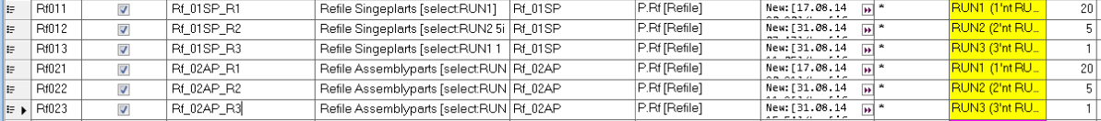
Refile Process Workflow Settings
Job.Rules in Detail
Edit Object Status
Entire Rules for SP and AP Refile

Slide 5
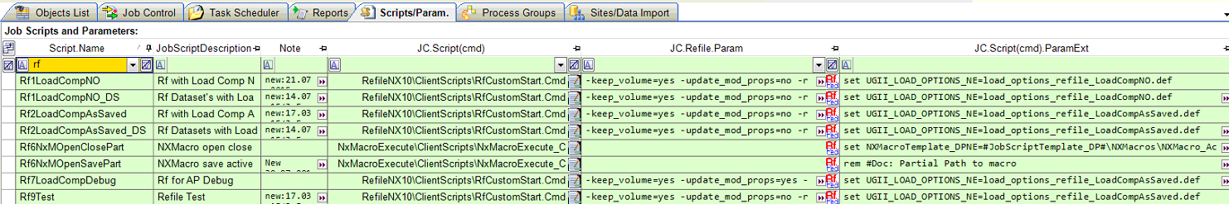
NX10.5 Settings
Scripts/Param.
Notes:
Rf1_SpOwnObj
Rf1_SpReplObj
Rf2_ApOwnObj
Rf1_ApReplObj
Rf3_Ap_McTryRun

Slide 6
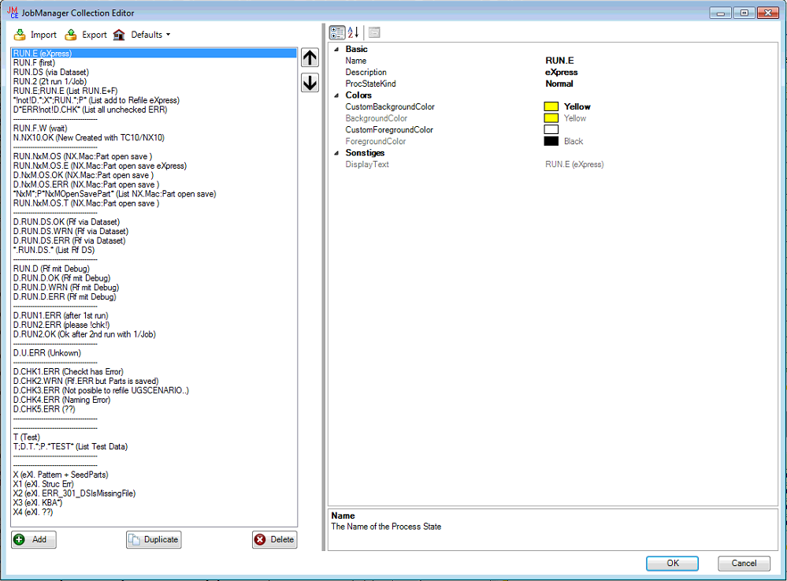
NX10.5 Settings
Scripts/Param.
Notes:
Rf1_SpOwnObj
Rf1_SpReplObj
Rf2_ApOwnObj
Rf1_ApReplObj
Rf3_Ap_McTryRun

Slide 7
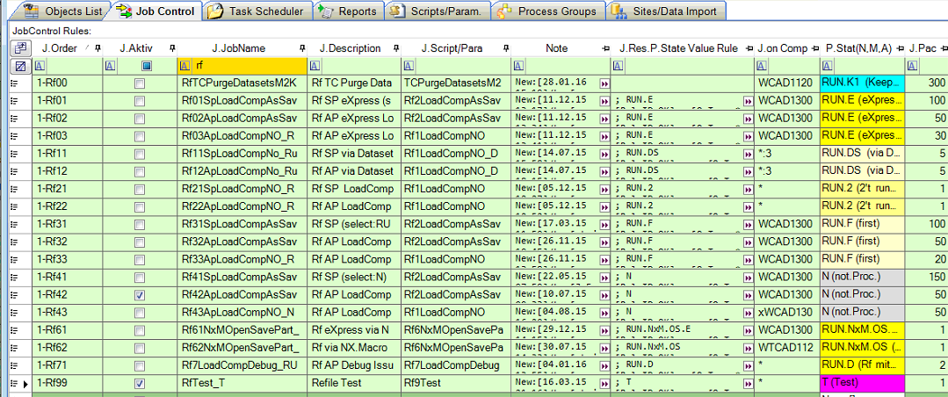
NX10.5 Settings
Job Control
Notes:
Rf1_SpOwnObj
Rf1_SpReplObj
Rf2_ApOwnObj
Rf1_ApReplObj
Rf3_Ap_McTryRun

Slide 8

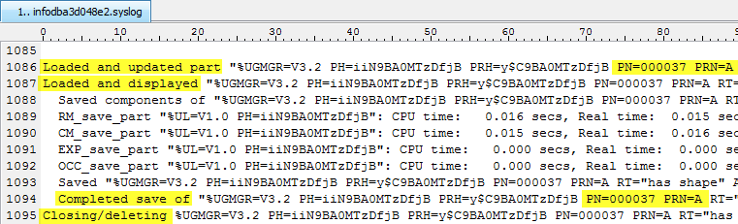
Refile Method is enhanced
Following enhancement has bee done to optimize Refile Process
Nx.Syslog file is now also scanned → better overview because less need to view Nx.Sylog by Hand
All analyses are done by JobClient via JobClientCmd Tools → Process time improved because JobClient do the analyses less lost Job’s
Jobs now Automated splittes Owing and Replica Object’s → less refile rules required
Section Rf.log
Section Nx.Sylog
Notes:
000037/A
[Rf:OK][Rf.NX.Syslog:LoadUp:OK,LoadDisp:OK,Save:OK,SecEnd:OK]

Slide 9
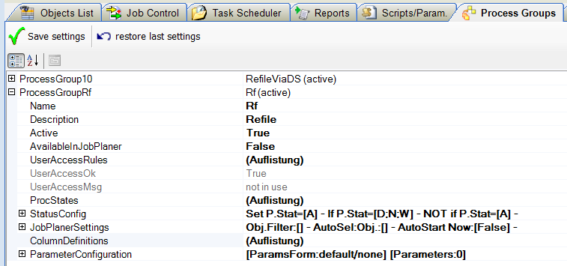
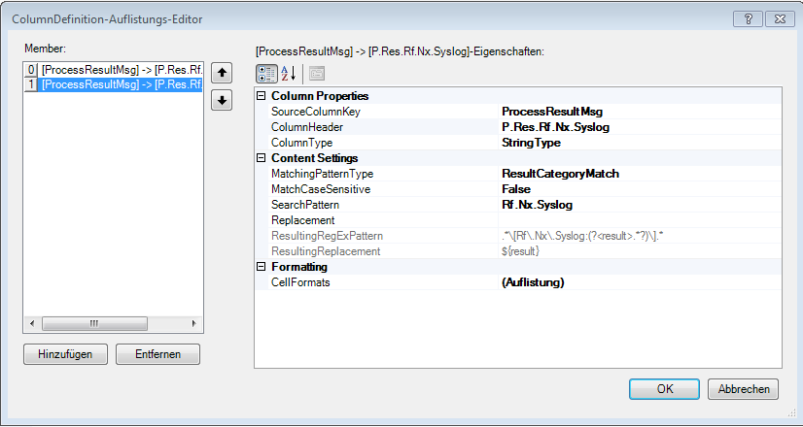
Refile Section configuration
Section Rf.log
Section Nx.Sylog
Notes:
000037/A
[Rf:OK][Rf.NX.Syslog:LoadUp:OK,LoadDisp:OK,Save:OK,SecEnd:OK]
[Rf:OK][Rf.MCS:OK: 15n][Rf.NX.Syslog:LoadUp:OK,LoadDisp:OK,Save:NO,SecEnd:OK]

Slide 10
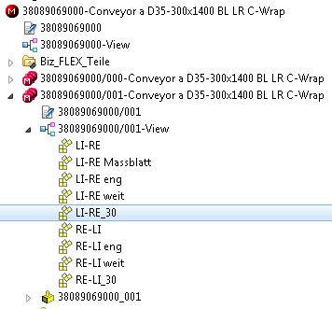
Refile for create Arrangements SyArr
Required parameter to create ‘NX Arrangements’ in TC via Refile Refile Paramter: -non_masters=no -structure_sync=from_teamcenter -force_structure_sync=yes -sync_arrangements=yes
Use load option: load_options_refile_SyncArrangements.def set UGII_LOAD_OPTIONS_NE=load_options_refile_SyncArrangements.def
Use Customer defaults : nx_refile_SyncArrangements.dpv
Settings in JobRules: set TcSetArrangementsOwnerRight=TRUE set JobMgr_BOMCompair=ON
TC setting IR9064301 TC_Arrangement_error_when_used_anchor_not_found = 0
Hint: most of knowledge is found by Mr. Arne Fritz from Company Bizerba
#Lup:20.02.2018/J.Fes

Slide 11
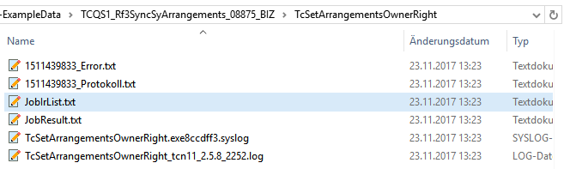
Refile for create Arrangements SyArr
TcSetArrangementsOwnerRight

Slide 12


#Templates – Designs #Version: 07.02.2018/J.Fes
1
XX
XX
# Standard Labels
2
XX
XX
OK
XX
XX
WRN
XX
XX
ERR
XX
XX
XX
XX
XX
XX
# Standard Symbols
# Colour coding
Document description
Isssue description
# Standard Connection lines
#ToDo descrption
#Done desctprion

