Slide 1
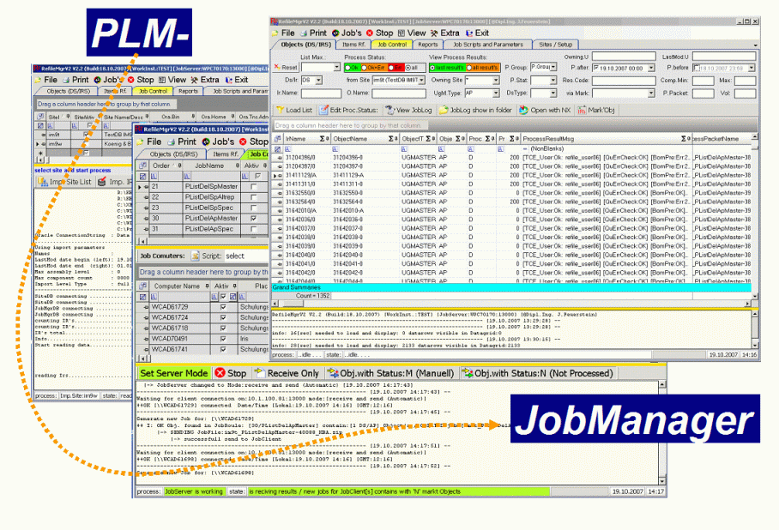
Cover sheet
#Custom# Project
NX11 – Refile at ProdSystem
Creator : Josef Feuerstein // Josef.Feuerstein@addPLM.com
LastUpdate: 21.09.2017

Slide 2
Content of section

Slide 3
Task description
Task ‚Refile – NX11‘ :
Part of NX11 Upgrade project where to refile all NX Data into version NX11. For this Task all NX data has been opened and saved into NX11 version. Process has been done with NX tool ugmanager_refile_program.exe.
Through this process it is achieved that
Loading of parts are faster because NX – Data are already in NX11 format
Conversion of Linewith has been done
All NX Data is saved in the new version. (inc. Released Data and Part-family-members)
Also Replica parts has been refiled
The following Software Version has been used during refile:
NX 11.0.1.11 MP1, 28Feb17. See Maintenance Pack letter for detailed list of fixes.
TC10.1.7 (V10000.1.0.70_20161101.00)
PLMJobManager V3.1428 (Build:31.08.2017)
Refile has been done on following sites
XX using 3 Hosts with 4 Cores and 32 GB Memory
XX using 2 Hosts with 4 Cores and 32 GB Memory
YY using 6 Hosts with 4 Cores and 32 GB Memory + 1 for Interactive refile ‘pattern parts’ via JobMgr scriptin

Slide 4
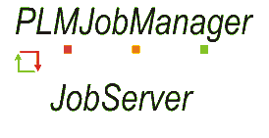



System Sketch TC + JobManager (productiv environment)
Vol1
C3
Refile via 2-tier
C4
Import
JobMgr DB + Config
JobServer
DB (MSSQL)
Vol2
Teamcenter
VDH
Veldhoven/NL
C2
C2
C1
Vol3
DEMCHTC00PA.ww500.siemens.net
C3
Refile via 2-tier
C2
C3
Refile via 2-tier
C2
C3
Refile via 2-tier
C2
Template Replace
Wilton/USA
Teamcenter
WLT
Linkow/Taiwan
Teamcenter
ACE
San Diego/USA
Teamcenter
SAN
Vol1
Vol1
Vol1
C4
C4
C4
Vol2
Import
Vol2
Import
Vol2
Import
C1
C1
Nr | Description | Connect via:
C1 | communication JobServer MS-SQL | TCP:1433 UDP: 1434
C2 | communication JobClinet – JobServer | Port:13000 – 13100 // 14000 - 14100
C3 | ugmanager_refile_program.exe (2-tier) | Handel by IT
C4 | Import Meta Data from TC Db | Uses TnsNames.ora like (C3)
System prerequisite
Teamcenter inc. all volumes data
The Volumes need to have +1/3 free diskspace
Example.: fpr 100 GB NX Data we need 33 GB of free disc space
Oracle Read Only User reading data from TC. Database.
TC Refile User with DBA right
TC Refile User mast have read write right’s on all Volumes
Script to get TC Prompt.
JobClients with TC 2Tier client and NX in the correct version
Remote Access to NX Refile JobClient‘s
600 MB of Network disk space for PLMJobmanager Software Installation and configuration
~1 GB Network diskspace for JobProcess Logfiles for each 250.000 Parts to refile

Slide 5
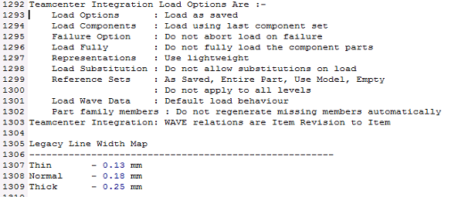
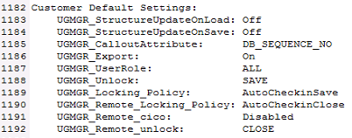
Refile settings an methodes
Refile Methodes :
Data has been refiled in ButtonUp Prinzip so first all Singelparts and then Assemblies has been refiled. Assemblies are refiled in order ascendendig by levels and components. With this method we achieve to refile assemblis where there subcomponents has been refiled before.
In following table you see the used refile parameter and settings.
Additional because of TC Issue Associated PR Number(s): 7912475, 7884777, 7941876 it was needed to use an additional TC-tool to correct tc file owner ship.
Type | Descrption | Refile Parameter:
Owing Site Objects | Rf with Load Comp NO | -keep_volume=yes -update_mod_props=no -refile_released=yes -bypass=yes -use_default_load_option_file -non_masters=yes -convert_line_widths + set UGII_LOAD_OPTIONS_NE=load_options_refile_LoadCompNO.def
Remote Site Objects | Rf with Load Comp NO | -keep_volume=yes -update_mod_props=no -refile_released=yes -bypass=yes -use_default_load_option_file -non_masters=yes -convert_line_widths -replica_bypass=yes -replace_file=yes + set UGII_LOAD_OPTIONS_NE=load_options_refile_LoadCompNO.def + set UGII_UGMGR_REFILE_REPLACE_FILE=yes + SET UGII_UGMGR_ALLOW_REFILE_REPLICA_BYPASS=true + SET IMAN_UG_REFILE_REPLACE_FILE=true + set UGII_DISABLE_PREVIEW=ON + set UGII_DISABLE_QAF_NAMED_REFS=ON
Template Replace
Used settings extracted from NX.syslog files
More Details for used settings please review:
Slide(s): ‘Check settings and Result 19.08.2017 ~22:20’

Slide 6
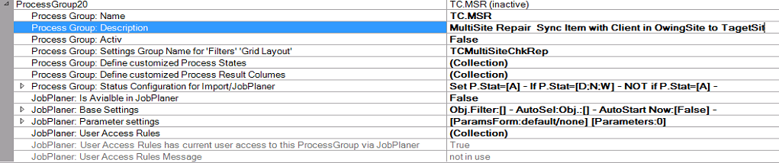
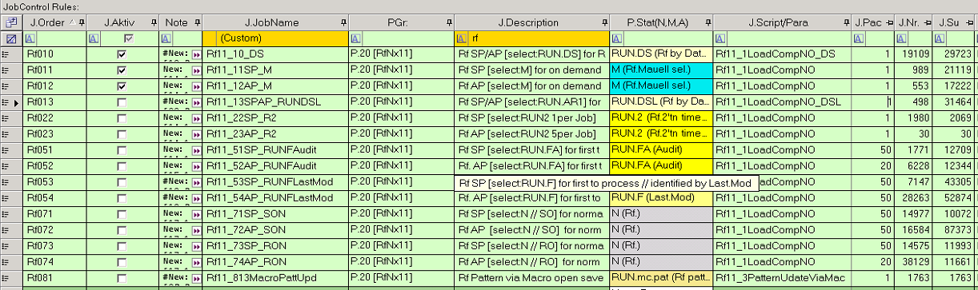
Refile settings in JobManager
PGR.20 is used for NX11 Refile
Template Replace
Define Refile Order

Slide 7
Content of section

Slide 8
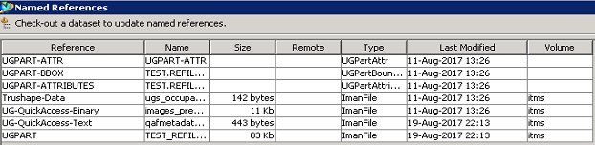
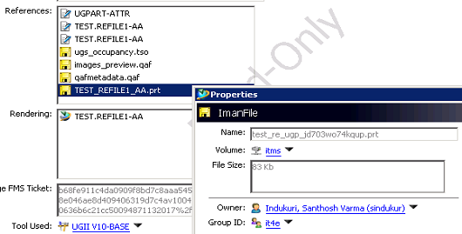
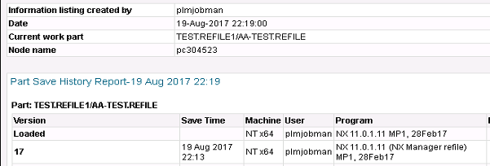
Check settings and Result 19.08.2017 ~22:20
Template Replace
OK
Check Result of Change OwerTool
Check Result of Part History
OK
OK

Slide 9
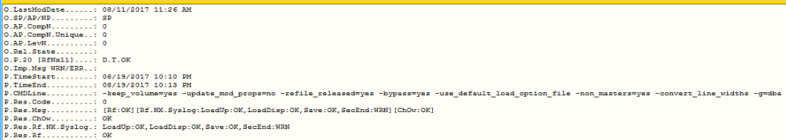
Check settings and Result 19.08.2017 ~22:20
Check Result of Logfiles
OK
OK
Check Result of Site.dpv
OK
OK
OK

Slide 10
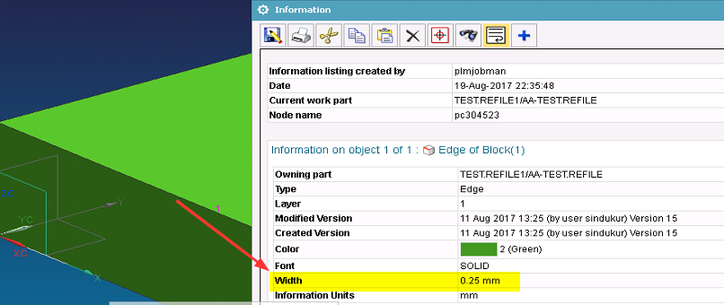
Check settings and Result 19.08.2017 ~22:20
Template Replace
OK

Slide 11
Content of section

Slide 12
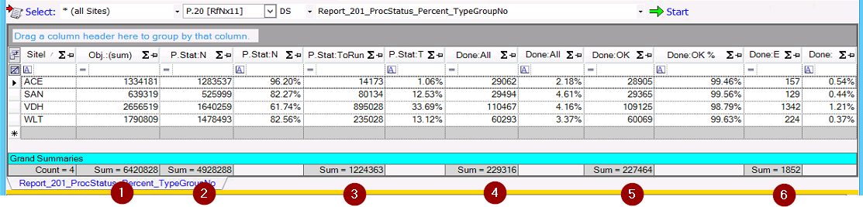
Process Report 20.08.2017 ~08:35
Template Replace
We have from 6.4 Mil Parts (1) currently 229316 (4) Parts refiled We have found 1852 (6) parts with refile errors.
Focus is to refile most of parts from P.Stat:ToRun (3)
Legend:
1 - Obj.:(sum) = sum of all NX Datasets
2 - P.Stat:N = sum of Datasets not refiled until now
3 - P.Stat:ToRun = sum of Datasets need be refiled via dataset refile = found by Audit and Last Used Parts
4 - Done:ALL = sum of Datasets that are refiled
5 - Done:OK = sum of Datasets that are refiled with status OK
6 - Done:ERR = sum of Datasets that are refiled with status Error
Notes:
Refile is working as we do expected.

Slide 13
Content of section

Slide 14
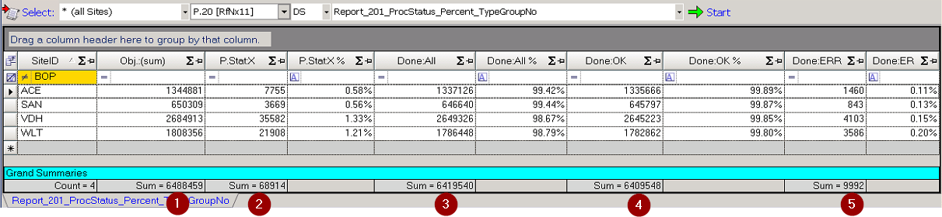
Process Report 20.09.2017 for all Sites
Template Replace
Final results:
- From all NX Datasets at #Custom# Databases 6.488.459 Mil Parts(1)
- has been 68.914 Parts(2) eXcludet from refile.
6.419.540 Parts (3) where tried to be refiled
From (3) we refile 6.409.548 Parts (4) successful
From (3) we have found 9992 (5) parts with refile errors.
Legend:
- Obj.:(sum) = sum of all NX Datasets
- P.Stat:X = sum of Datasets are eXcludet from refile out of issues
- Done:ALL = sum of Datasets that are tried to be refiled
- Done:OK = sum of Datasets that are refiled with status OK
- Done:ERR = sum of Datasets that are refiled with status Error
Notes:
eXludes are done for: Parts that cannot be refiled like CAE* (Example: CAEMesh, CAESolution)
eXludes are done for: Parts having TC Issues like ERR_301_DSIsMissingFile, ERR_302_DSHasMutiCADFiles, ERR_150_IrHasDsWithSameName
Refile results and analyse are available in: 13-#Custom#_ALL_ProdSystem_AnalyseHappendErrors.xlsx

Slide 15
Content of section

Slide 16
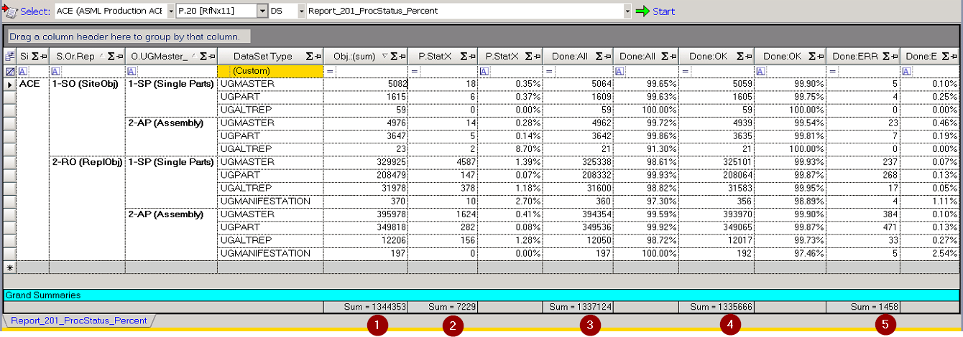
XXX Report #Date# Refile Statistic
Template Replace
Legend:
- Obj.:(sum) = sum of all NX Datasets
- P.Stat:X = sum of Datasets are eXcludet from refile out of issues
- Done:ALL = sum of Datasets that are tried to be refiled
- Done:OK = sum of Datasets that are refiled with status OK
- Done:ERR = sum of Datasets that are refiled with status Error
Notes:
eXludes are done for: Parts that cannot be refiled like CAE* (Example: CAEMesh, CAESolution)
eXludes are done for: Parts having TC Issues like ERR_301_DSIsMissingFile, ERR_302_DSHasMutiCADFiles, ERR_150_IrHasDsWithSameName
Refile results and analyse are available in: 13-#Custom#_ALL_ProdSystem_AnalyseHappendErrors.xlsx

Slide 17
XXXX NX-Refile Report 20.09.2017 Detailed Lists
In the excel-files you can find the following Results:
All documents for Site are stored in this Directory:
\\#Custom#.com\eu\shared\nl011072\plmjobman\JobManagerV3_P\11-Documentation.Custom\81-RefileNX11ProdSystem\04-RefileReports\01-ACE
Overview over all eXcludet Datasets:
\\#Custom#.com\eu\shared\nl011072\plmjobman\JobManagerV3_P\11-Documentation.Custom\81-RefileNX11ProdSystem\04-RefileReports\01-ACE\01-#Custom#_ACE_ProdSystem_AllDatasets_eXcludet_becauseOf_Issues.xlsx
All datasets having refile errors:
\\#Custom#.com\eu\shared\nl011072\plmjobman\JobManagerV3_P\11-Documentation.Custom\81-RefileNX11ProdSystem\04-RefileReports\01-ACE\02-#Custom#_ACE_ProdSystem_AllDatasets_WithRefileErrors.xlsx
Overview over all happened errors including result codes and result messages:
\\#Custom#.com\eu\shared\nl011072\plmjobman\JobManagerV3_P\11-Documentation.Custom\81-RefileNX11ProdSystem\04-RefileReports\01-ACE\03-#Custom#_ACE_ProdSystem_AllHappendErrors_Final.xlsx

Slide 18
Content of section

Slide 19
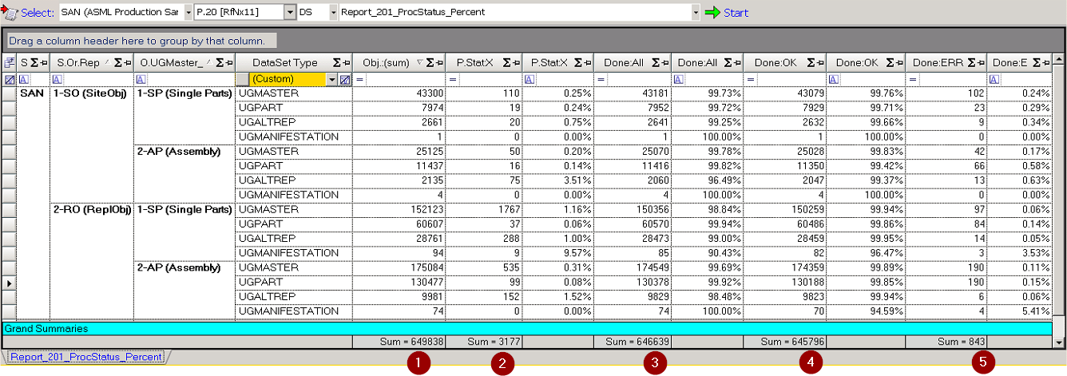
XX Report 20.09.2017 Refile Statistic
Template Replace
Legend:
- Obj.:(sum) = sum of all NX Datasets
- P.Stat:X = sum of Datasets are eXcludet from refile out of issues
- Done:ALL = sum of Datasets that are tried to be refiled
- Done:OK = sum of Datasets that are refiled with status OK
- Done:ERR = sum of Datasets that are refiled with status Error
Notes:
eXludes are done for: Parts that cannot be refiled like CAE* (Example: CAEMesh, CAESolution)
eXludes are done for: Parts having TC Issues like ERR_301_DSIsMissingFile, ERR_302_DSHasMutiCADFiles, ERR_150_IrHasDsWithSameName
Refile results and analyse are available in: 13-#Custom#_ALL_ProdSystem_AnalyseHappendErrors.xlsx

Slide 20
XXX NX-Refile Report 20.09.2017 Detailed Lists
In the excel-files you can find the following Results:
All documents for Site are stored in this Directory:
\\#Custom#.com\eu\shared\nl011072\plmjobman\JobManagerV3_P\11-Documentation.Custom\81-RefileNX11ProdSystem\04-RefileReports\02-SAN
Overview over all eXcludet Datasets:
\\#Custom#.com\eu\shared\nl011072\plmjobman\JobManagerV3_P\11-Documentation.Custom\81-RefileNX11ProdSystem\04-RefileReports\02-SAN\01-#Custom#_SAN_ProdSystem_AllDatasets_eXcludet_becauseOf_Issues.xlsx
All datasets having refile errors:
\\#Custom#.com\eu\shared\nl011072\plmjobman\JobManagerV3_P\11-Documentation.Custom\81-RefileNX11ProdSystem\04-RefileReports\02-SAN\02-#Custom#_SAN_ProdSystem_AllDatasets_WithRefileErrors.xlsx
Overview over all happened errors including result codes and result messages:
\\#Custom#.com\eu\shared\nl011072\plmjobman\JobManagerV3_P\11-Documentation.Custom\81-RefileNX11ProdSystem\04-RefileReports\02-SAN\03-#Custom#_SAN_ProdSystem_AllHappendErrors_Final.xlsx
Template Replace

Slide 21
Content of section

Slide 22
Content of section

Slide 23
ACE NX-Refile Report 14.09.2017 Issue: Datasets below folder of revision
We have found the issue that some datases are not viewed under revision but under folder of revsion
TC Analyse
Template Replace
Refile Analyse
Refile analyses from Refile Logfile: Rf:ERR:File not found
Notes:
J:\JobManagerV3_P\90-DATA\#Custom#_WorkInst_ProdSystem\10-JobLogArchiv\ACE_Rf11_10_DS\ACE_Rf11_10_DS_11144_#Custom#.7z

Slide 24
#Templates - Designs
1
2
XX
XX
XX
XX
XX
XX
XX
XX
XX
XX
XX
XX
XX
XX

